Slide 1
K-Nearest Neighbors Algorithm
Dr. Kavita S. Oza

Slide 2
Introduction
Supervised machine learning algorithm.
It is classification algorithm , can also be used in regression problems.
Algorithm assumes that similar things exist in close proximity
It captures the idea of similarity (distance, proximity, or closeness) with some mathematics(Euclidian distance, Manhattan distance, Weighted distance).
It assumes the similarity between the new data and available data, and put the new data into the category that is most similar to the available categories.
Algorithm stores all the available data and classifies a new data point based on the similarity.

Slide 3
K-Nearest Neighbors (K-NN)
Classifies the whole data into training data and test sample data.
The distance between training points and sample points is evaluated, and the point with the lowest distance is said to be the nearest neighbor.
Predicts the result on the basis of the majority.
Does not make any assumption on underlying data.
It is also called a lazy learner algorithm.
At the training phase just stores the dataset and when it gets new data, then it classifies that data into a category that is much similar to the new data.

Slide 4
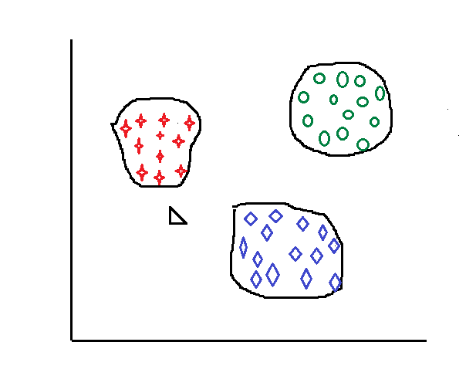
Basic KNN algorithm
Find the Euclidean distance and k as 5 nearest neighbors.
Among the 5 closest neighbors, 3 belong to class- A and 2 belongs to class-C, so New data is assigned to class- A.
The basic KNN algorithm stores all the examples in the training set, creating high storage requirements (and computational cost).
Class-B
Class-A
New data
Class-C

Slide 5
Working of K-NN
Whole data is classified into training and test sample data.
Select the number K of the neighbors, where k is the number of training examples in the feature space.
Calculate the distance of new data points from all the training examples. Calculate the Euclidean distance of K number of neighbors
Search for the k observations in the training data that are nearest to the measurements of the new data point
Take the K nearest neighbors as per the calculated Euclidean distance. The training data which is having the smallest value will be declared as the nearest neighbor
Among these k neighbors, count the number of the data points in each category.
Assign the new data points to that category for which the number of the neighbor is maximum.

Slide 6
K Value
If k is chosen large it will be less sensitive to noise and hence performance increases.
If k is chosen small it will be able to capture fine structures if exist in the feature space.
if k is too small (K=1 or K=2) it may lead to overfitting i.e. algorithm performs excellently on the training set and its performance degrades on new test data.

Slide 7
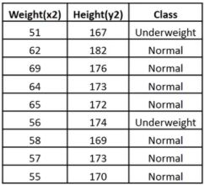
Example
Consider a dataset that contains two variables: height (cm) & weight (kg).
Each point is classified as normal or underweight.

Slide 8

Example…
Based on the above data, classify the following set as normal or underweight using the KNN algorithm.
A new data point (x1, y1), and we need to determine its class.

Slide 9
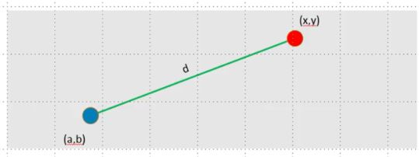

Example…
Find the nearest neighbors, calculate the Euclidean distance.
The Euclidean distance between two points in the plane with coordinates (x,y) and (a,b) is given by:

Slide 10
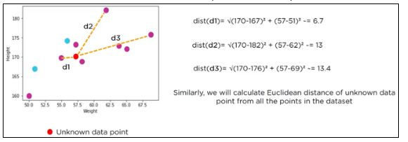
Example…
Calculate the Euclidean distance with the help of unknown data points.

Slide 11
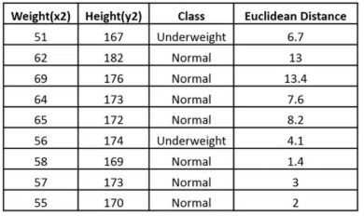
Example…
The following table shows the calculated Euclidean distance of unknown data points from all points.

Slide 12
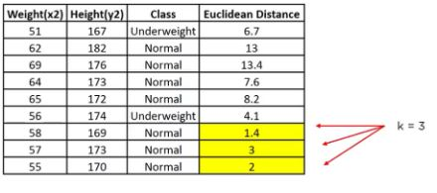
Example…
Now, determine its class.
Looking at the new data, we can consider the last three rows from the table—K=3.

Slide 13
Example…
Since the majority of neighbors are classified as normal as per the KNN algorithm, the data point (57, 170) should be normal.

Slide 14
Practical implementation: Using Jupiter notebook
Import the modules needed.
scikit-learn is a popular library for machine learning in Python.
import matplotlib.pyplot as plt
from sklearn.neighbors import KNeighborsClassifier
X= weight, Y= height, classes= Whether normal or underweight
x=[51, 62, 69, 64, 65, 56, 58, 57, 55, 54]
y=[167, 182, 176, 173, 172, 174, 169, 173, 170, 174]
#classes = ['U', 'N', 'N', 'N', 'N', 'U', 'N', 'N', 'N', 'U']
classes = ['red', 'blue', 'blue', 'blue', 'blue', 'red', 'blue', 'blue', 'blue', 'red']

Slide 15
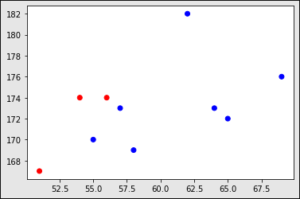
Plotting data
plt.scatter(x, y, c=classes)
plt.show()
x=[51, 62, 69, 64, 65, 56, 58, 57, 55, 54]
y=[167, 182, 176, 173, 172, 174, 169, 173, 170, 174]
classes = ['red', 'blue', 'blue', 'blue', 'blue', 'red', 'blue', 'blue', 'blue', 'red']

Slide 16

Pairing of data
Turn the input features into a set of points:

Slide 17
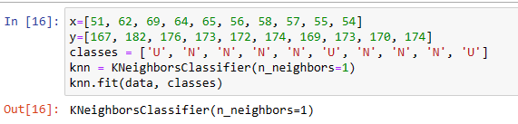
Training KNN model with K=1

Slide 18
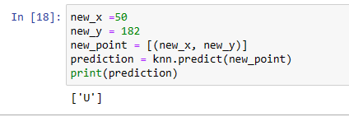
Making predictions for unseen data
Training dataset
x=[51, 62, 69, 64, 65, 56, 58, 57, 55, 54]
y=[167, 182, 176, 173, 172, 174, 169, 173, 170, 174]
classes = ['U', 'N', 'N', 'N', 'N', 'U', 'N', 'N', 'N', 'U']

Slide 19
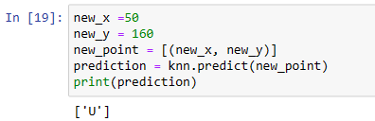
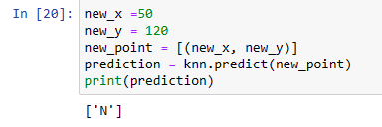
Making predictions for unseen data…

Slide 20
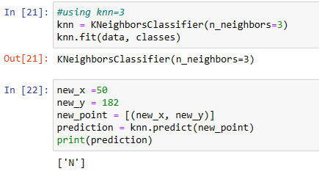
K=3

Slide 21
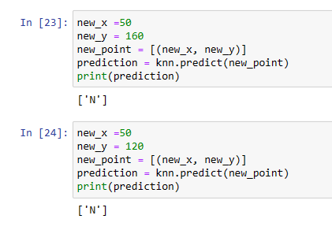
Predictions for K=3

Slide 22
For plotting
x=[51, 62, 69, 64, 65, 56, 58, 57, 55, 54]
y=[167, 182, 176, 173, 172, 174, 169, 173, 170, 174]
classes = ['red', 'blue', 'blue', 'blue', 'blue', 'red', 'blue', 'blue', 'blue', 'red']
knn = KNeighborsClassifier(n_neighbors=1)
knn.fit(data, classes)

Slide 23
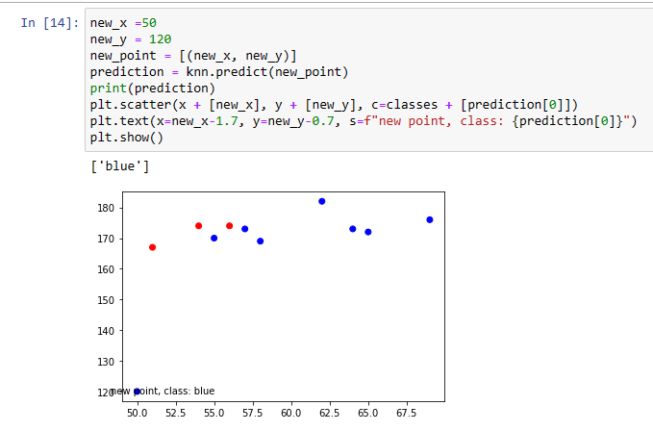
Plotting new point prediction

Slide 24
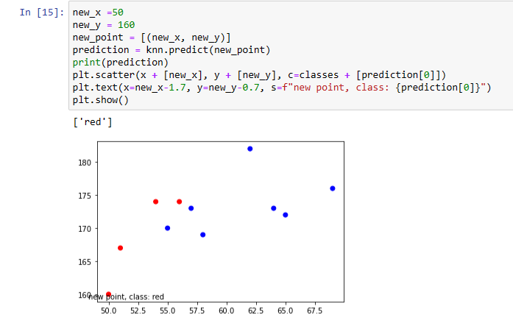
Plotting new point prediction…

Slide 25
Applications
Speech Recognition
Handwriting Detection
Image Recognition and Video Recognition
Facial recognition
Recommendation systems

Slide 26
Advantages
It is very simple to understand and implement.
Robust to noisy data.
The decision boundaries can be of arbitrary shapes.
It requires only a few parameters to be tuned.
K-NN classifier can be updated at a very little cost.
The algorithm is versatile. It can be used for classification, regression, and search.

Slide 27
Drawbacks
K-NN is computationally expensive.
It is a lazy learner i.e. it uses all the training data at the runtime and hence is slow.
Complexity is O(n) for each instance to be classified.
Always needs to determine the value of K which may be complex some time.
The algorithm gets significantly slower as the number of examples and predictors variables increase.

Slide 28
Thank you

